Slide 1

Introduction to Lab Automation Course – day 1
Instructors: Dr. Danielle Honigstein Dr. Lior Segev
12.7 – 16.7 2026

Slide 2
Introducing the speakers
Physics Core Facilities – https://www.weizmann.ac.il/pcf/
Lab Automation Unit – Lior Segev
Noam Sobel Lab - https://www.weizmann.ac.il/brain-sciences/worg/
Senior developer - Danielle Honigstein

Slide 3

How about you?

Slide 4
Course Goals
You will be able to build an automated experimental setup in your lab using software (C and Python, etc.) and hardware (buttons, screens, motors, etc.)

Slide 5
Course Requirements
Attendance for course hours is mandatory
Submitting your project code and exercises via Git repo

Slide 6
Inventory List
Grove Beginner Kit For Arduino – includes the Arduino development board and peripherals - https://wiki.seeedstudio.com/Grove-Beginner-Kit-For-Arduino
ADALM 2000 – encompasses several instruments among them is the oscilloscope - https://wiki.analog.com/university/tools/m2k/users
https://www.youtube.com/playlist?list=PLE6soOeVPOJ0Pj5sMui4KPDiTa7HY50y3
Seeed Grove Beginner kit for Arduino Education add on pack – https://www.ratoeducation.be/fr/grove-beginner-kit-for-arduino-education-add-on-pa.html https://wiki.seeedstudio.com/Grove-Beginner-Kit-for-Arduino-education-pack/
Handful of connecting wires
This hardware will be reused in future courses. So, please take good care of it.

Slide 7
Setting up
Connecting the scopy and Grove kit to the computer via USB
Installing software
Arduino IDE - https://www.arduino.cc/en/software
Visual Studio code - https://code.visualstudio.com/
Github Desktop - https://github.com/apps/desktop
Configuring software
Python plugin in visual code
Github copilot plugin in visual code
Install packages in Arduino
Choosing a serial port and board in the Arduino IDE
Creating a python environment using Conda
Scopy (installed) - https://wiki.analog.com/university/tools/m2k/scopy

Slide 8
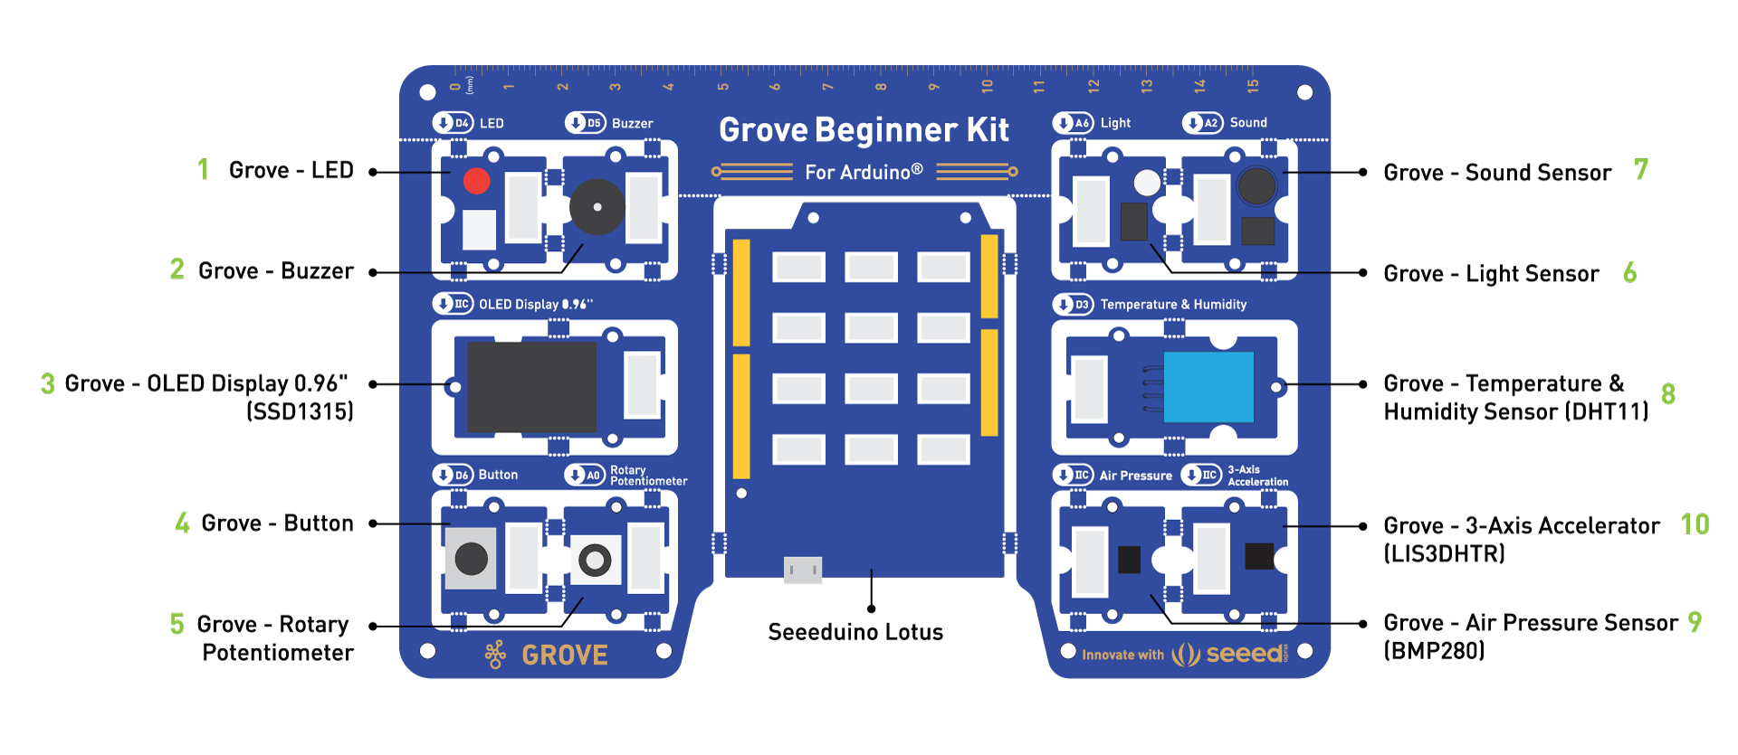
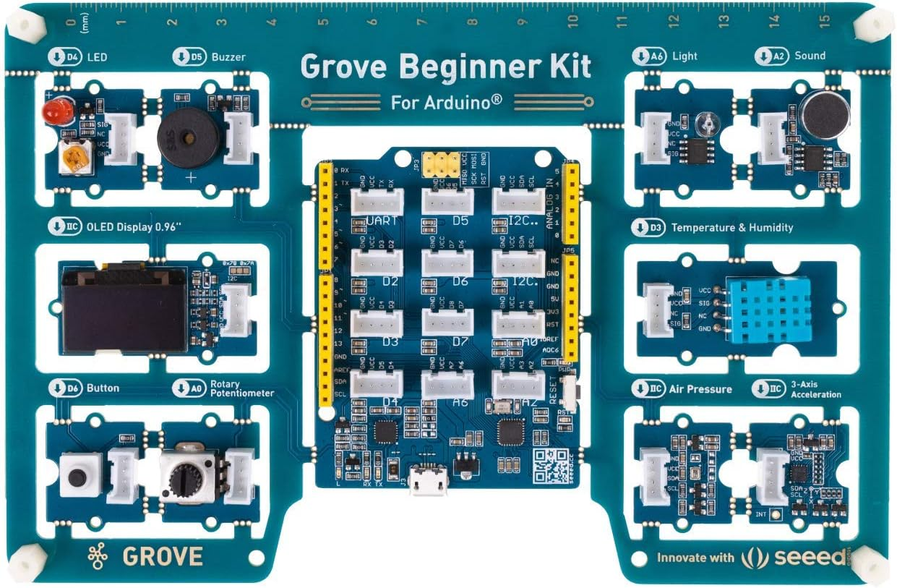
Grover kit

Slide 9
Course Outline
Developing automation devices for experimental setups using hands-on approach.
Learning to program computer programs using two programming languages, namely C and Python
Learning what is the Oscilloscope (scope in short) and how to use it and other instruments such as logic analyzers, signal generators and digital multimeters in the context of building a microcontroller based device
Use the Arduino framework and micro-controller as our main device for developing experimental setups
Learn how to use and operate several peripheral devices to the Arduino, such as: Pushbutton, Potentiometer knob, OLED screen, Servo and DC motors and accelerometer
Learn how to establish a communication link via the serial port between the PC and the uController and how to look at the data in real time using the Oscilloscope to debug potential bugs.
Learn about concept of latency and how it is minimized when using a uController. We will measure the latency of our systems using the scope
Working with Git and open source projects.
Learning basic concepts in electronics such as for example: Voltage and Current

Slide 10
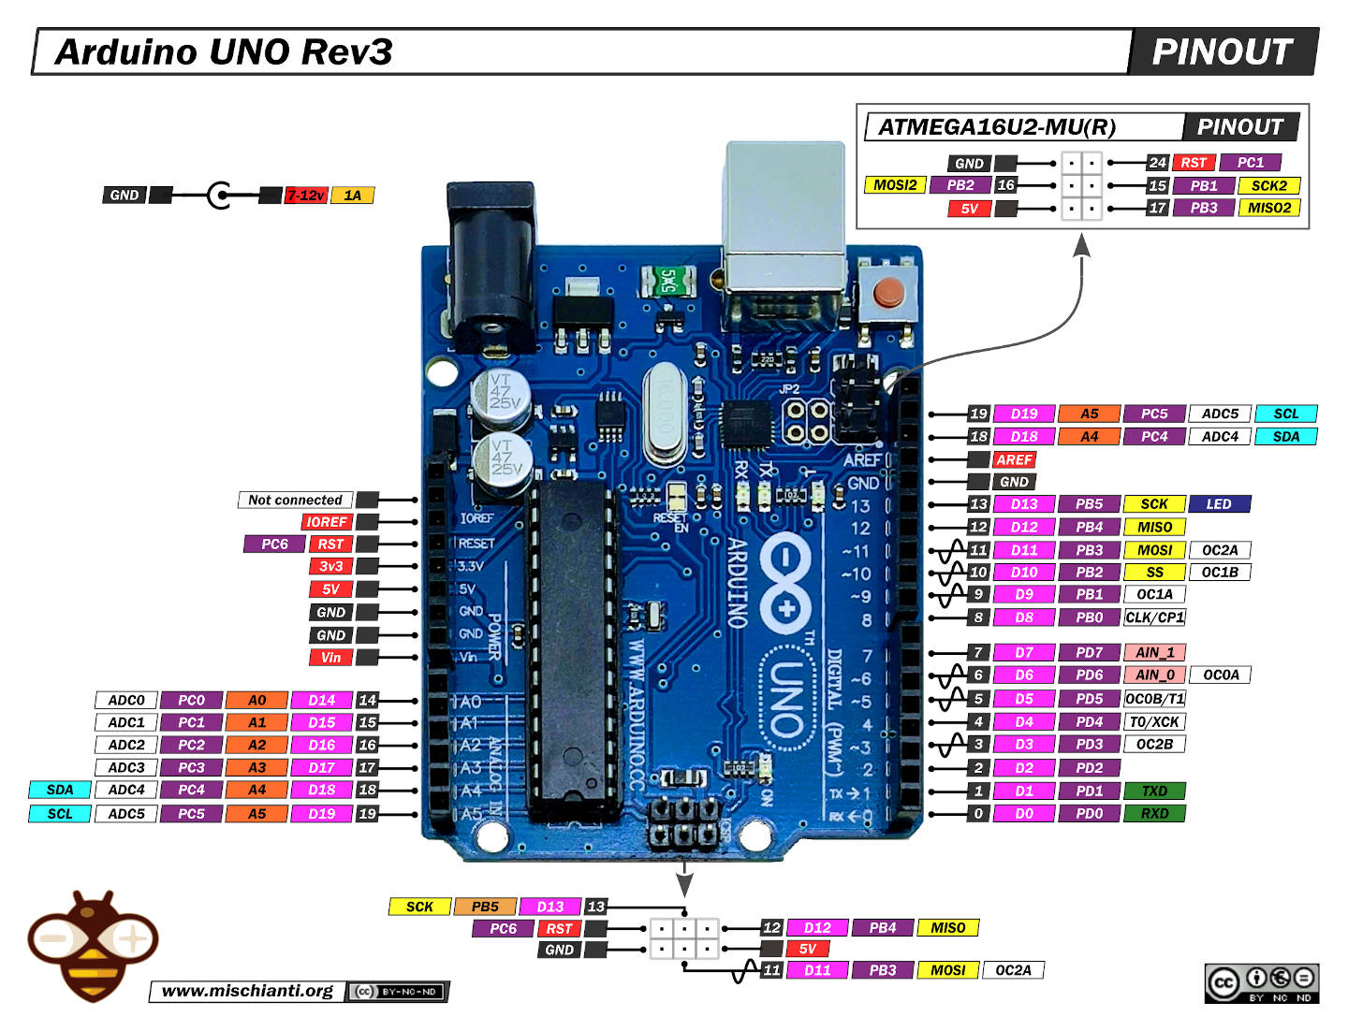
The Arduino

Slide 11
Testing that everything works
Testing the Grove (Arduino Setup) - Test writing an example to the board
Test Scopy is functional by running the scpe instrument

